Slide 1
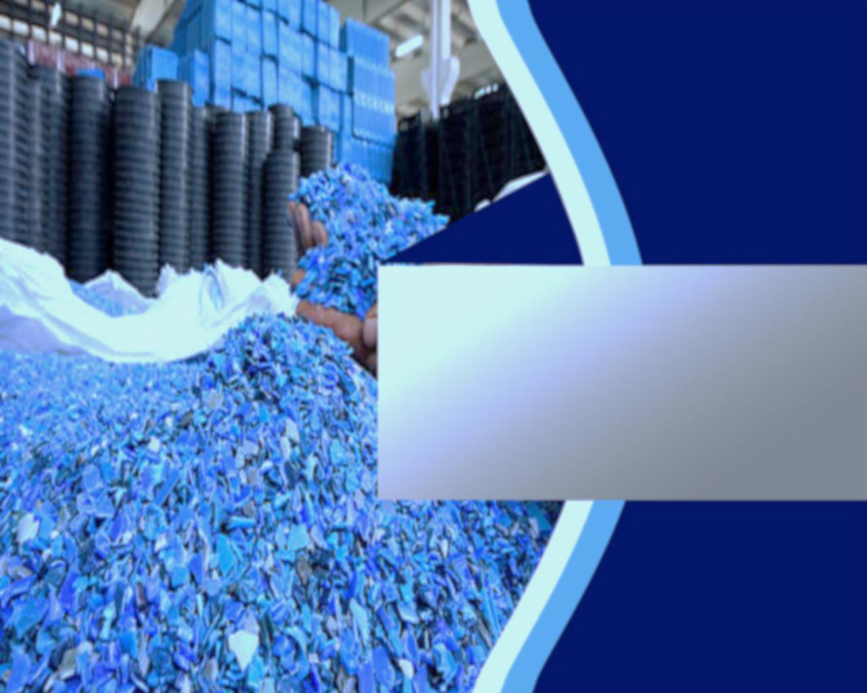
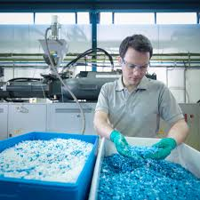
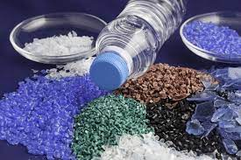
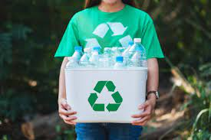
Plastic recycling
Presenting by H.A.Ishara Chamodi
RAT/IT/2021/F/0045

Slide 2
1
Table of content
Project Introduction
2
Problem Statement of Plastic recycling
3
Objectives of plastic recycling
4
Methodology of plastic recycling
5
Budget Analysis From Database
6
TimeLine of my project

Slide 3
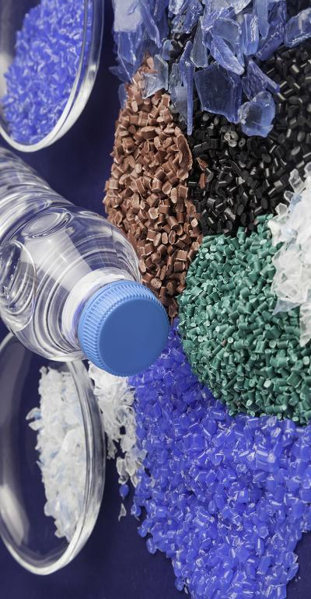
In today's world, there is an increasing trend of consumer goods made of plastic in the form of goods, materials and packaging.
Plastics are increasingly used in the manufacture of electrical appliances and motor vehicles. Accordingly, with the modernization of people's lifestyle, the use of plastic products has increased.
The word plastic is derived from the Greek word "plastikos" which means "ability to change shape without breaking".
Most of the plastics we use are made from petrochemicals.
Plastics with different properties are produced with additives such as polymers and color stabilizers.
using And the fillers used in the production of plastic, the plastic is high in strength and does not react with water.
The ability to buy at a low price for these reasons has rapidly spread in the plastic society.
However, the adverse effects of plastic are that it does not decompose easily, is not reactive in water, and produces various gases when burned.
Accordingly, the impact of plastic has become a major factor in creating massive environmental problems.
Because of these environmental impacts, plastic recycling is important.
Project Introduction

Slide 4
Problem Statement
of Plastic Recycling
What is the main problem of plastic?
The problem with plastics is that most of them are not biodegradable. It doesn't rot like paper or food, instead it can hide in the environment for hundreds of years. Every year, 400 million tons of plastic are produced, of which 40% is single-use.
How is plastic waste managed?
In these waste management strategies, several are scientifically based, such as recycling, incineration, bioremediation, and landfills. These methods are established to have a clean environment and good plastic waste disposal.
Why should Sri Lanka ban single-use plastics?
Plastics have polluted beaches and created plastic islands in some oceans and become deadly for ocean species. Moreover, Micro plastics in the oceans, water, soil, food, body and the ecosystems have become a that to the health of people and the planet.

Slide 5
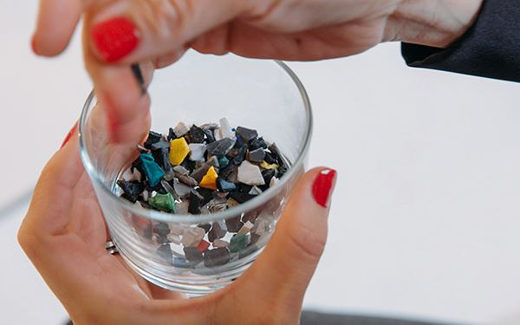
Objectives of plastic recycling
Objectives of plastic recycling
Saves Energy
Conserves resources
Reduces pollution
Cuts waste disposal costs
Saves valuable raw materials and Reduces trash in landfills
The goal of recycling plastic is to reduce high rates of plastic pollution while putting less pressure on virgin materials to produce brand new plastic products. This approach helps to conserve resources and diverts plastics from landfills or such as oceans.

Slide 6
Reclamation of thermoplastic domestic waste
Methodology
Cleaning
Drying
Filtering for resin type
Filtering for size
Reclamation of industrial waste plastic
Crushing & Shredding
Cleaning
If needed
Drying
Granulation
Extrusion to form bulk component

Slide 7
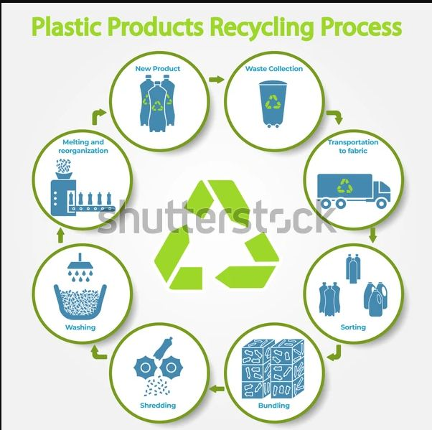
Plastic recycling process

Slide 8
Methodology
Of Plastic Recycling
All the plastics collected from the environment are collected in factories where these plastics are reformed under high heat. This process is done in several stages.
Collecting plastic
Sending through collected plastic machines
Shredding of plastic
Making plastics reusable ( recycling )

Slide 9
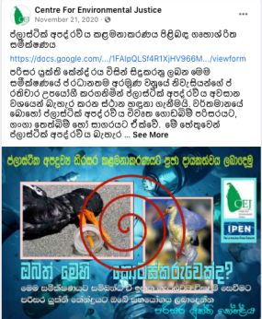
CEJ Conducted On Household Survey On Plastic Waste Management With The Participation Of 200 Households.
The summary of responses is given below.
40% respondents carry own bag for shopping .
75% of the people use 1-10 plastic bags weekly. 82.7% separated plastic waste from other waste.
55% handed over the plastic waste to the municipality tractor/lorry .
29% burned the plastic waste openly.
90% of the people have no idea where their trash is ending.
How to collect Plastics at home

Slide 10
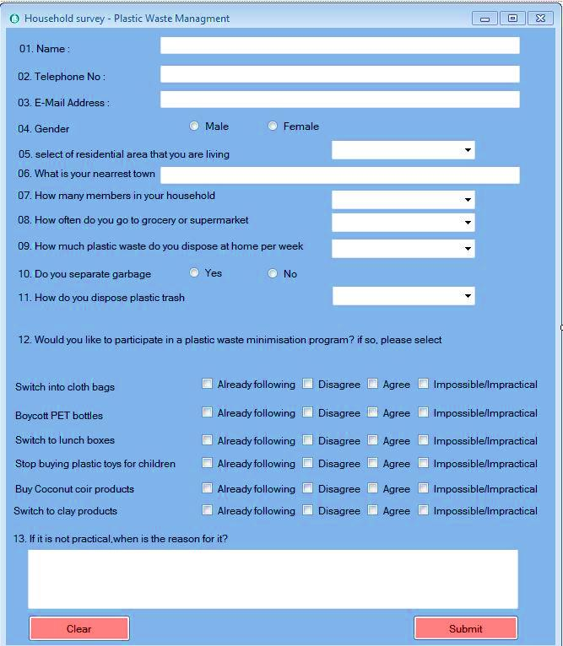
Household Survey Plastic Waste Management Form
(Go to form)

Slide 11

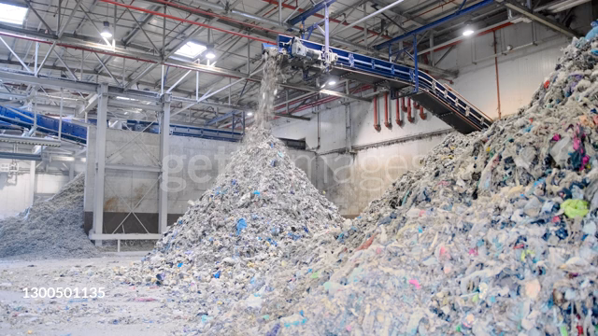
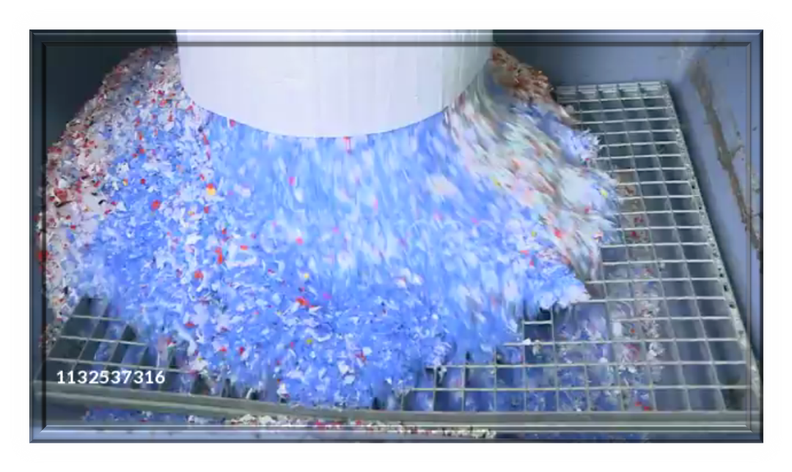
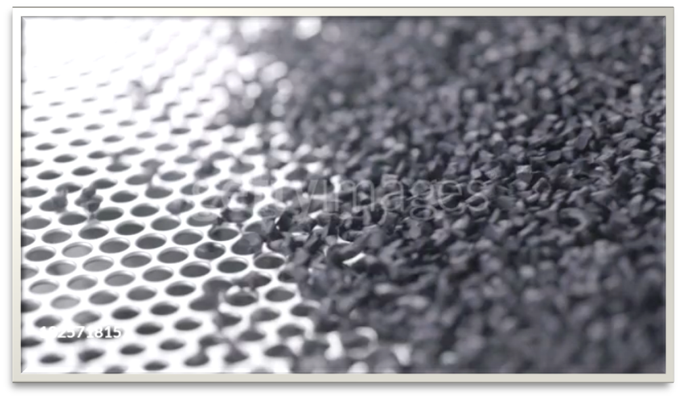
Collecting of plastic
&
Sending through collected plastic machines
Shredding of plastic
Making plastics reusable ( recycling )

Slide 12
MONTH | AUGUST |  |  |  | SEPTEMBER |  |  |  | OCTOBER |  |  |  | NOVEMBER
WEEK | W 1 | W 2 | W 3 | W 4 | W 1 | W 2 | W 3 | W 4 | W 1 | W 2 | W 3 | W 4 | W1 | W 2 | W 3 | W 4
Project Proposal
Project Planning
Implementation of the project
Project monitoring And control
Completion of the project
Time Line

Slide 13
Thank you

